Slide 1
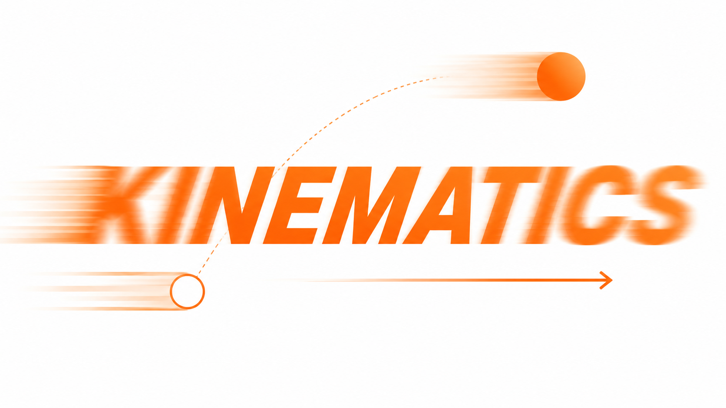
Physics 1
Projectile & Circular Motion
Motion in Two Dimensions — A First-Hand Investigation
Prepared by Engr. Philip Jayson L. Lestojas

Slide 2
Motion in Two Dimensions — Today's Target
Today's competency, stated plainly: carry out first-hand investigations involving 2-dimensional projectile and circular motion to investigate factors such as speed, radius, and centripetal force.
Two big ideas for the day, side by side:
Projectile Motion — a curved path caused by gravity alone, where speed and direction both change.
Circular Motion — a curved path caused by a center-seeking pull, where speed stays constant but direction constantly changes.
Physics 1
Prepared by Engr. Philip Jayson L. Lestojas
Notes:
Frame the whole session as answering one question twice: "why does this path curve, and what controls how much it curves?" We'll answer it first for things that fly through the air, then for things that spin. By the end of the hour, students should be ready to physically test the second answer with their own hands.

Slide 3
The Shape Hiding in Plain Sight
A diver leaving a cliff. Sparks flying off a welder's torch. Water arcing out of a park fountain.
All three trace the exact same curve — even though nobody planned it that way.
That curve has a name: the parabola, and it shows up any time something launches into the air and gravity is the only thing acting on it afterward.
Physics 1
Prepared by Engr. Philip Jayson L. Lestojas
Notes:
Open with the vivid images rather than the definition. Ask students what a diver's fall, welding sparks, and a fountain jet could possibly have in common - let them sit with that for a second before revealing it's the same geometric shape. This is the aha that should anchor the whole first half of the lesson: gravity writes the same signature every time.

Slide 4
Locating a Particle in Two Dimensions
In one dimension, a single number tells you where something is.
In two dimensions, you need two numbers at once — an x-position and a y-position — tracked simultaneously, not one after the other.
This pair is bundled into a single arrow called the position vector, pointing from the origin to wherever the object currently is.
Physics 1
Prepared by Engr. Philip Jayson L. Lestojas
Notes:
Keep this brief and conversational - students already have vector intuition from the prior unit. The key upgrade here is simultaneity: x and y aren't happening in sequence, they're happening together, at the same instant, for the same object.

Slide 5
Breaking Velocity Into Two Directions
Any launch velocity can be split into two perpendicular ingredients:
v_{x} = v_{i} cos θ_{i} v_{y} = v_{i} sin θ_{i}
Think of a cannon fired at an angle: part of its "push" sends the ball forward, part of it sends the ball upward — and trigonometry tells you exactly how much of each.
This is the only piece of vector-splitting needed for today — no adding multiple vectors together yet (that's Aug 4's job).
Physics 1
Prepared by Engr. Philip Jayson L. Lestojas
Notes:
This is a minimal decomposition - one vector, split into two pieces. Be explicit that this is not the full vector-addition unit students will get in a week; it's just enough trigonometry to separate one launch velocity into its horizontal and vertical ingredients.

Slide 6
The Independence Principle
Picture a hockey puck gliding in a straight line across a frictionless table.
Someone gives it a single sideways puff of air. The puck now drifts diagonally — but its original forward speed never changed one bit.
The generalization: motion in two dimensions can be modeled as two independent motions in each of the two perpendicular directions — a nudge in y never touches what's happening in x, and vice versa.
This is the single most important idea in projectile motion. Everything else today builds on it.
Physics 1
Prepared by Engr. Philip Jayson L. Lestojas
Notes:
This is the air-hockey-puck thought experiment straight from the reference text. Walk through it slowly: the puck moves at constant velocity in x; a puff of air in y adds a y-velocity but the x-velocity is completely unaffected. That independence is what lets us solve horizontal and vertical motion as two separate, simpler problems instead of one tangled one.

Slide 7
The Governing Equations of Projectile Motion
Two separate "mini-problems" run on the same clock, t — horizontal is constant velocity, vertical is constant acceleration (a = –g):
x_{f} = x_{i} + v_{xi}t y_{f} = y_{i} + v_{yi}t – ½gt²
v_{yf} = v_{yi} – gt
g is the only acceleration in the whole system, and it only ever touches the y-equations.
Physics 1
Prepared by Engr. Philip Jayson L. Lestojas
Notes:
This slide is the payoff of Slide 5 - students now see the independence principle turned into an actual toolkit. Emphasize the problem-solving habit: horizontal motion is always the easy constant-velocity equation; vertical motion is always the familiar free-fall equation from the previous unit, just relabeled with y instead of x.

Slide 8
Special-Case Shortcuts — Range and Max Height
When a projectile launches and lands at the same height, two shortcut formulas save time:
h = v_{i}² sin²θ_{i} / 2g R = v_{i}² sin 2θ_{i} / g
Important boundary: these only work for a symmetric trip — same launch and landing level. If a ball is thrown off a cliff or lands on a slope, these formulas don't apply — go back to the full equations from the previous slide instead.
Physics 1
Prepared by Engr. Philip Jayson L. Lestojas
Notes:
Present these as convenience tools, not new physics - they're just Slide 7's equations pre-solved for one common situation. Stress the boundary condition hard; it's the single most common source of error when students first meet these formulas, since they're tempted to use them everywhere.

Slide 9
How Launch Angle Changes the Flight
Same speed, different angle → dramatically different paths.
A shallow angle sends an object far but low; a steep angle sends it high but not far.
Somewhere between those extremes is a launch angle that maximizes horizontal distance for a given speed — the range formula reveals which angle that is, without needing to test every possibility by hand.
Physics 1
Prepared by Engr. Philip Jayson L. Lestojas
Notes:
Keep this qualitative and visual - the goal is intuition, not derivation. A useful classroom demo: ask students to picture throwing a ball almost flat versus almost straight up, and predict which travels farther. Most will correctly sense that neither extreme wins.

Slide 10
How Launch Speed Changes the Flight
Same angle, different speed → same shape, different scale.
Doubling the launch speed doesn't just double the range — because speed appears squared in both the range and max-height formulas, the effect compounds fast.
This matters anywhere launch speed is the variable an athlete, engineer, or animal can actually control — angle is often fixed by circumstance, but speed rarely is.
Physics 1
Prepared by Engr. Philip Jayson L. Lestojas
Notes:
Tie this directly back to the puma example - animals and athletes usually can't easily change their launch angle mid-jump, but they absolutely can generate more speed through stronger muscles or a longer running start. That's the real-world lever most commonly pulled.

Slide 11
From Straight Lines to Circles — A New Kind of Motion
Everything so far involved a changing speed and a changing direction, both driven by gravity.
Now: a Ferris wheel car, a satellite in orbit, a car rounding a curve — all moving at roughly constant speed, yet still very clearly not moving in a straight line.
That's circular motion — a different curved path, driven by a completely different cause.
Physics 1
Prepared by Engr. Philip Jayson L. Lestojas
Notes:
This is a short signpost slide, not a deep dive - just enough to reset student expectations before the vocabulary shift. Ask: if speed isn't changing, is this thing accelerating at all? Don't answer yet - that tension carries directly into the next few slides.

Slide 12
Uniform Circular Motion Defined
When an object travels a circular path at a constant speed, physicists call it uniform circular motion — common enough to earn its own name and its own toolkit of equations.
A spinning record, a carousel horse, a satellite in a circular orbit — all textbook examples of the same underlying motion.
The one thing that's always true: the velocity vector is tangent to the circle at every instant, and perpendicular to the radius.
Physics 1
Prepared by Engr. Philip Jayson L. Lestojas
Notes:
Draw the always-tangent idea out physically - imagine releasing a ball mid-spin on a string; it flies off in a straight line tangent to the circle at the release point, not toward the center and not along the circle. That tangent direction is the velocity direction at that instant.

Slide 13
Why Constant Speed Still Means Accelerating
Common misconception: "constant speed" means "no acceleration." False.
Acceleration is a change in velocity — and velocity is a vector, made of both speed and direction.
In circular motion, the speed never changes, but the direction is changing at every single instant — and that alone is enough to count as acceleration.
Physics 1
Prepared by Engr. Philip Jayson L. Lestojas
Notes:
This deserves real airtime - it's one of the most persistent misconceptions in the whole unit. Use a whirling ball on a string: ask is its speed changing? (no) is its direction changing? (constantly) so is it accelerating? (yes). Make students say the answer out loud before moving on.

Slide 14
Centripetal Acceleration — Always Toward the Center
a_{c} = v² / r
Called centripetal acceleration — literally "center-seeking."
It always points from the object straight toward the center of the circle, never along the path itself.
Bigger speed or smaller radius → bigger acceleration. That relationship is the entire foundation of today's upcoming investigation.
Physics 1
Prepared by Engr. Philip Jayson L. Lestojas
Notes:
Don't derive this from scratch - that similar-triangles proof belongs in a more advanced course. What matters here is the shape of the relationship: acceleration grows with the square of speed, and grows as radius shrinks. Have students predict, before revealing the formula, whether doubling the speed should double or quadruple the acceleration - most will guess wrong.

Slide 15
Measuring the Motion — Period and Speed
T = 2πr / v
The period T is simply the time for one full lap around the circle.
Useful because T is often the number you actually know in real life — a satellite's orbital period, a wheel's rotations per minute, a Ferris wheel's ride time — while v is usually the harder number to measure directly.
This equation is really just "distance = speed × time," rearranged, applied to the circle's circumference.
Physics 1
Prepared by Engr. Philip Jayson L. Lestojas
Notes:
Frame this as a practical translation tool rather than new physics - it converts between how fast and how long per lap, two ways of describing the exact same motion. This sets up both upcoming worked examples, which each hand students a period-like quantity instead of a speed.

Slide 16
Centripetal Force — The Push Toward the Center
F_{c} = mv² / r
Acceleration doesn't happen on its own — something has to cause it. For circular motion, that cause is the centripetal force, always aimed toward the center, same direction as the acceleration it produces.
In real life, that force wears many disguises: tension in a swung string, friction between tires and road on a curve, gravity pulling a satellite inward.
This formula is really just Newton's second law (F = ma), applied to the acceleration formula — a preview of the dynamics work coming on August 4th.
Physics 1
Prepared by Engr. Philip Jayson L. Lestojas
Notes:
Keep this conceptual and forward-looking rather than diving into free-body diagrams - that formal force analysis is intentionally saved for the Newton's Laws lesson. The goal today is just for students to recognize that acceleration toward the center implies some force pushing toward the center, and to start noticing that force in everyday situations.

Slide 17
Heads-Up: A Gap in This Chapter's Problems
This textbook chapter covers circular motion purely as kinematics — acceleration, period, and speed — because force isn't formally introduced until the next chapter (Newton's Laws).
Result: none of this chapter's practice problems ask students to solve for centripetal force numerically.
Workaround: since Fᴄ = m·v²/r = m·aᴄ , force and acceleration scale identically for a fixed mass — every acceleration problem coming up doubles as a force problem in disguise, once mass is added.
Physics 1
Prepared by Engr. Philip Jayson L. Lestojas
Notes:
Be upfront about this with students rather than papering over it - it's a good moment to model how real curricula sometimes split a single topic across two chapters, and how a careful student can still connect the dots. Full force-based problem-solving with free-body diagrams is intentionally deferred to August 4th.

Slide 18
The Investigation Question — What Affects Centripetal Force?
Today's guiding question, the one students will physically test: how do speed and radius affect the centripetal force needed to keep an object moving in a circle?
Before any data collection, the variables need to be sorted:
Independent variables: speed and radius.
Dependent variable: centripetal force.
Controlled variable: the mass of the spinning object.
Physics 1
Prepared by Engr. Philip Jayson L. Lestojas
Notes:
This slide is the formal launch of the carry-out-first-hand-investigations half of the competency. Spend real time here making sure students can articulate, in their own words, which variables they're changing on purpose versus which one they're just watching change as a result.

Slide 19
Apparatus and Setup for the Investigation
Classic classroom setup: a small stopper (or rubber tube) tied to one end of a string, threaded through a hollow tube, with a set of washers hung from the other end to provide a known, adjustable pulling force.
The stopper is whirled overhead in a horizontal circle; the string length between hand and stopper sets the radius, and the speed of the whirl is adjusted so the hanging washers stay steady.
If a physical apparatus isn't available, a simulation of the same setup works identically for testing the same variables.
Physics 1
Prepared by Engr. Philip Jayson L. Lestojas
Notes:
Walk through the physical logic of why this setup works: the hanging washers provide a known, measurable force pulling the stopper inward - that known force stands in for centripetal force, letting students work backward to test the v-squared over r relationship. Emphasize basic safety: clear space, secure grip, safety glasses if available.

Slide 20
Predicting the Relationships Before Testing
Before collecting a single data point, use the formula itself to make a prediction:
F_{c} = mv² / r
Holding radius and mass fixed, doubling speed should quadruple the force needed (speed is squared).
Holding speed and mass fixed, doubling the radius should halve the force needed (radius is in the denominator).
Writing these predictions down before testing turns the lab from "collect random numbers" into "test a specific claim."
Physics 1
Prepared by Engr. Philip Jayson L. Lestojas
Notes:
This is standard scientific-method practice, and it's worth naming explicitly: a prediction made before data collection is a hypothesis; the same claim made after seeing the data isn't testing anything. Have students commit their predictions to paper before touching any apparatus.

Slide 21
From Data to Conclusion — Linking Results to the Formula
Collected numbers alone aren't a conclusion — a conclusion explains what the numbers mean.
A strong conclusion does three things: states what was changed, states what happened to the force as a result, and explicitly connects that pattern back to Fᴄ = m·v²/r.
Example structure (not a required script): "As the radius increased while speed was held constant, the measured force decreased — consistent with the inverse relationship predicted by the formula."
Physics 1
Prepared by Engr. Philip Jayson L. Lestojas
Notes:
This is where the lab work gets tied back to the theory taught earlier in the period. Push students to use the phrase consistent with (or inconsistent with, if their data doesn't match) rather than just describing what happened - that's the difference between reporting and interpreting data.

Slide 22
Projectile vs. Circular Motion — Two Types, One Framework
Cause of curving — Projectile: gravity (constant, downward); Circular: centripetal force (toward the center).
Speed — Projectile: changes throughout flight; Circular: stays constant.
Direction — Projectile: changes; Circular: changes.
Acceleration direction — Projectile: always straight down; Circular: always toward the center.
Everyday example — Projectile: a thrown ball; Circular: a car rounding a curve.
Both are genuinely two-dimensional motions — but the reason each one curves is completely different, and that difference is the entire story of today's lesson.
Physics 1
Prepared by Engr. Philip Jayson L. Lestojas
Notes:
Use this comparison as the closing synthesis - students should be able to fill in every point from memory by now. This is also a natural moment to acknowledge, briefly, that both types of motion assumed a stationary observer watching from the ground - a detail that becomes important very soon.

